Slide 1
Computer Vision and Image Processing
Tirgul 15
Stitching
& Moriya Bitton

Slide 2
Stitching

Slide 3
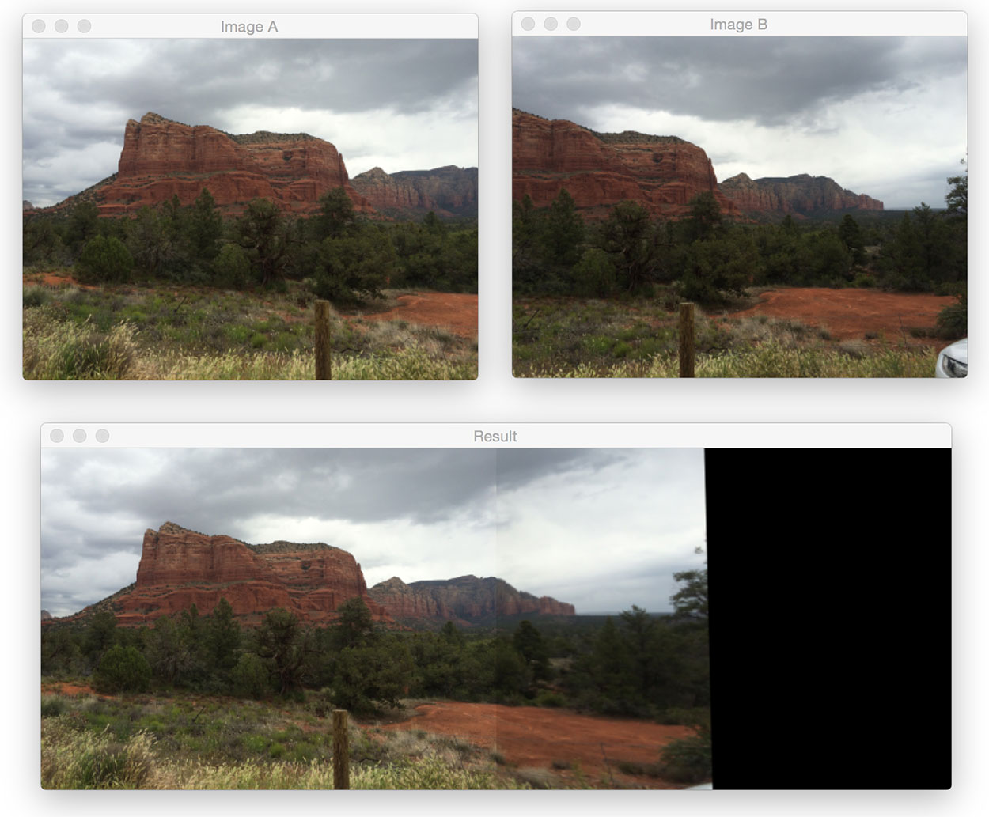
Stitching panorama

Slide 4
Simple solution - Alpha feathering
This might do the job.
The seam line will be less noticeable,
but since the images were taken separately, their brightness may differ.
One should normalize the images brightness, see gamma correction.

Slide 5
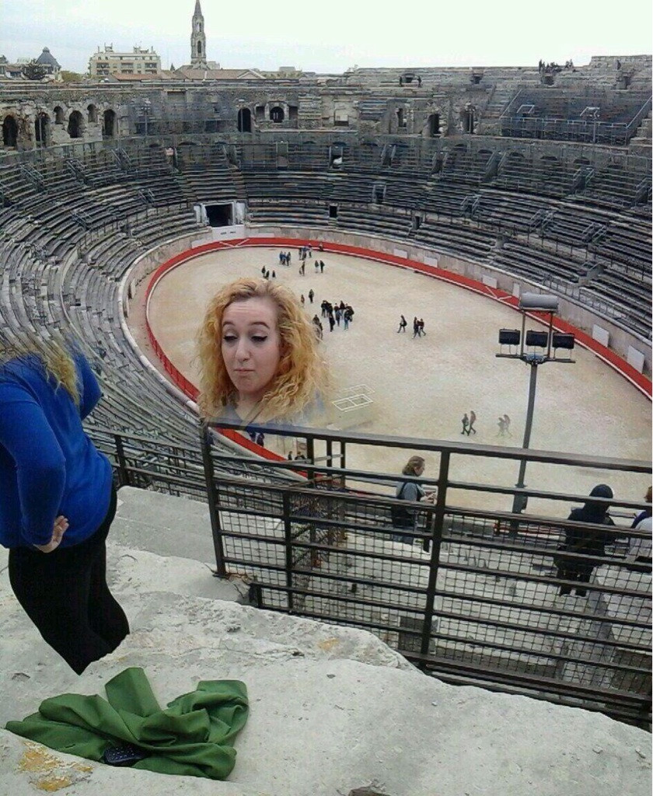
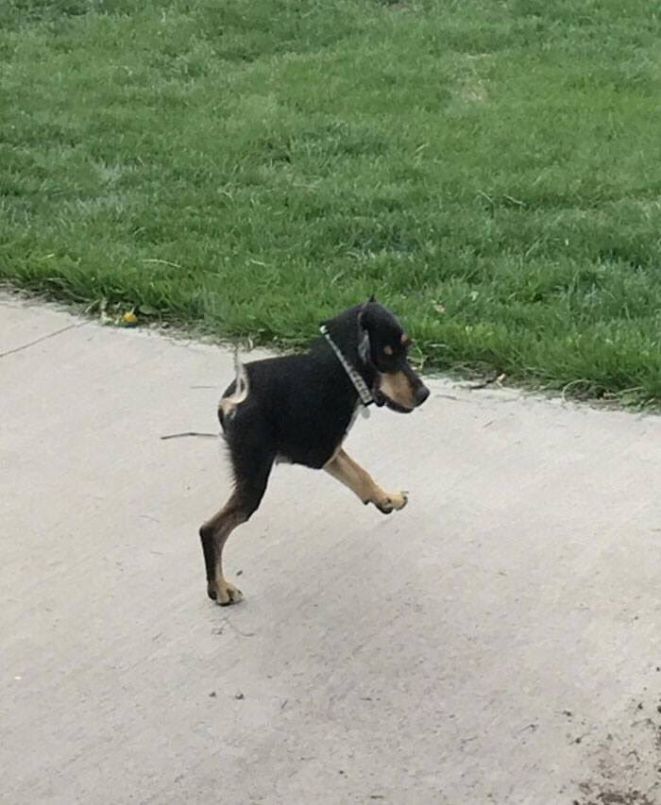
More Problems..
Another problem is if the seam line has changed too much (moving trees, people..) it will cause artifacts

Slide 6
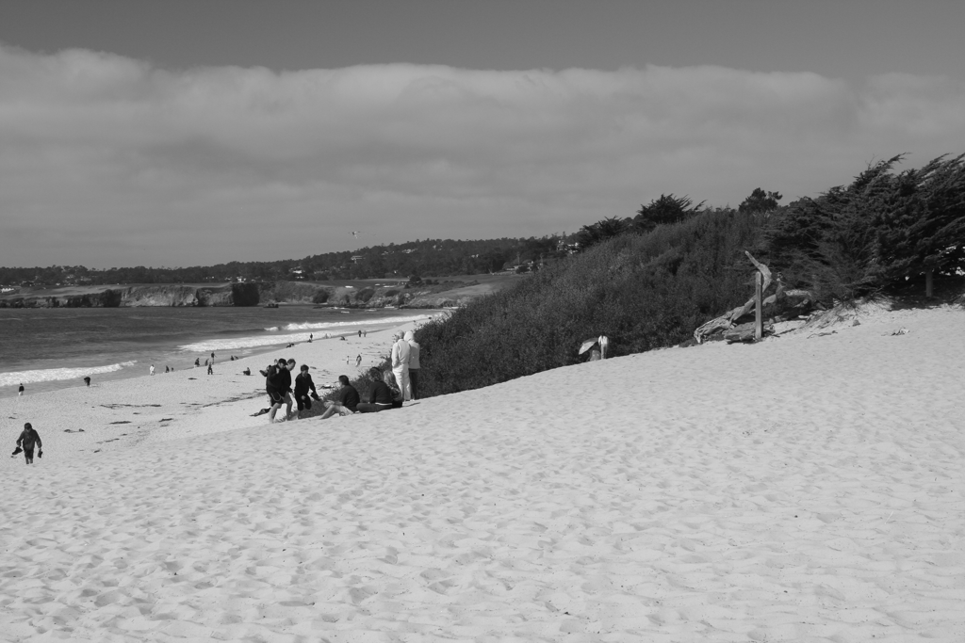
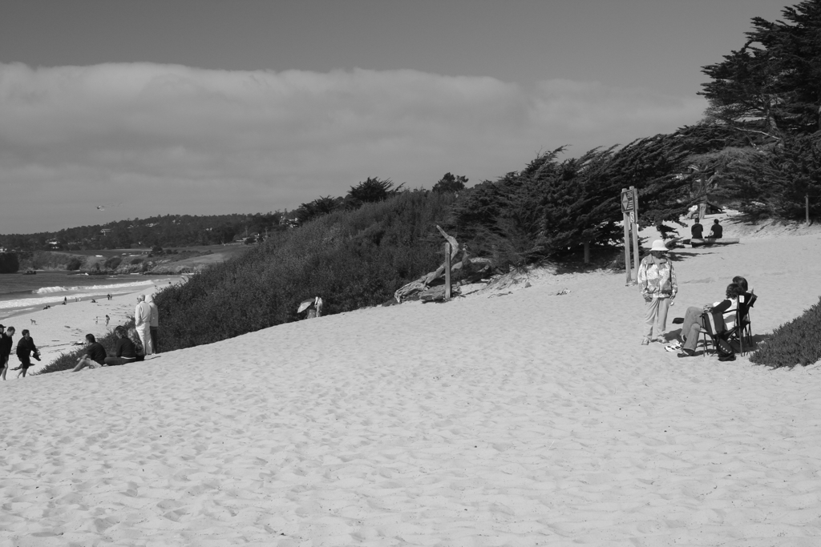
Dynamic Programing

Slide 7
Dynamic Programing

Slide 8
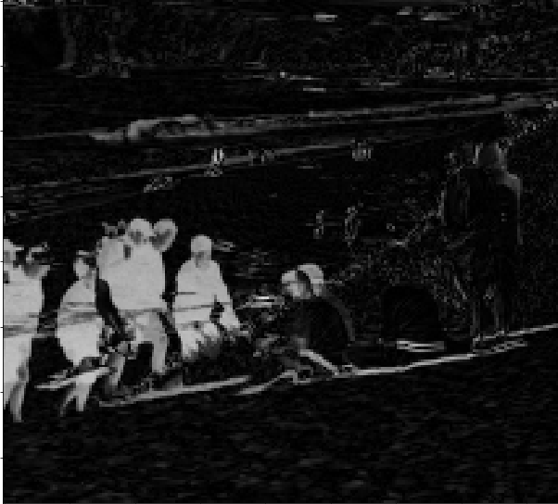
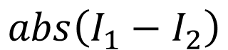
Dynamic Programing
$$abs\left(I_{1}−I_{2}\right)$$
Difference image

Slide 9
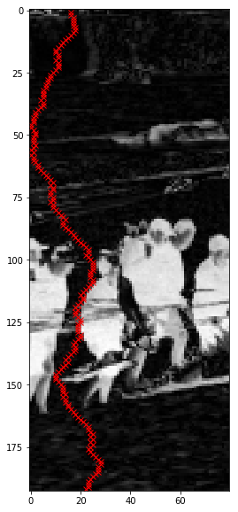
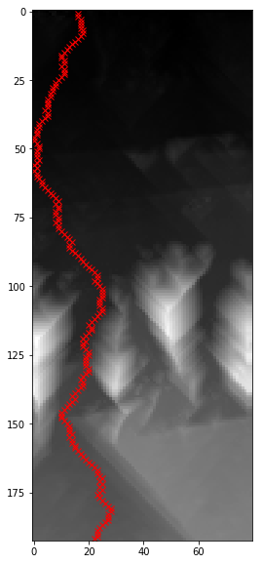
Dynamic Programing
$$abs\left(I_{1}−I_{2}\right)$$
Dynamic cost image
Difference image

